Slide 1
EMG Cases
Susan Stickevers, MD
Residency Program Director, SUNYSB Rehab Residency Program

Slide 2
A Case of Accidental Ingestion
2 months previously, an 18 yr old male had an accidental ingestion
Immediate Symptoms at time of ingestion : nausea & vomiting
Subsequently he developed weakness of his legs & numbness distal to his knees over the course of several weeks
PMH and Family History were non - contributory

Slide 3
Accidental Ingestion
Physical Exam:
Transverse white stria were present above the lunula of several nails
No weakness detected on manual muscle testing
Touch, vibration, and joint position sensation were diminished below the knees bilaterally
Plantar responses were flexor
Nerves were normal to palpation
DTRs were normal & active in the upper extremities, but absent in the lower extremities

Slide 4
Questions for the Residents
What do the neurological features suggest ?
How would you design an EMG / NCV study to elucidate the nature of the patient’s disorder ?
Which conductions would you perform ?
Which muscles would you study on needle exam ?

Slide 5
Motor Conduction Results
Motor Conduction | Latency | Conduction Velocity | Amplitude
Left Median | 3.7 | 50 | 8
Left Median F | 29
Left Peroneal | 5.6 | 41 | 2.6
Left Peroneal F | 55

Slide 6
Sensory Conduction Studies
Sensory Nerve Action Potentials | Latency | Amplitude
Left Median | No response
Left Ulnar | 3.4 | 3.8
Left Sural | 3.0 | 9.0
Left peroneal | 2.6 | 2.3

Slide 7
EMG
Muscle | Findings
Left Tibialis Anterior | Fibrillation Potentials and positive sharp waves at rest Normal and long duration polyphasics on volition
Left EDB | “ “
Left Lumbar Paraspinal | Silent at rest, Normal motor unit potentials on volition
Left Quadriceps | “ “
Left Tensor Fascia Lata | “ “

Slide 8
What is The Diagnosis ?
What is the process which we see ?

Slide 9
Is this a Polyneuropathy ?
If so, what type ?
What toxin could be responsible for this ?

Slide 10
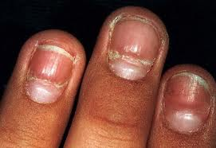
Diagnosis
Distal axonal polyneuropathy secondary to arsenic poisoning, primarily sensory > motor
Mee’s lines (transverse stria above the lunulae) are present on the nails
Arsenic interferes with neuronal metabolism by blocking pyruvate dehydrogenase
This results in distal degeneration of axons with very little segmental demyelination

Slide 11
Crutches & a Wrist Drop
Three months previously, a 31 yr old man fell, striking his right elbow & spraining his ankle
After using axillary crutches for 3 weeks, he developed diffuse weakness & numbness of his right upper extremity

Slide 12
Physical Exam
Weakness was present in his right triceps, brachioradialis, wrist & finger extensors, FCU, intrinsic hand muscles
Thenar muscles were spared
He had hypalgesia & hyperpathia over the entire hand
DTRs were active and symmetric except for a decreased right triceps reflex
Plantar responses were flexor

Slide 13
Questions
What nerve involvement is suggested by the pattern of weakness ?
In view of his history, what are the possible sites of involvement ?
What types of lesions occur in the axilla ?

Slide 14
Answers
Weak wrist & finger extensors suggest a radial nerve lesion – not localized in the spiral groove, it is more proximal due to involvement of the triceps
Hand muscle weakness sparing the thenar muscles suggests an ulnar lesion – the lesion is not at the elbow because FCU is involved

Slide 15
Answers
The three week delay between injury and deficit argues against nerve damage occurring at the time of the fall
Crutch usage could have caused a lesion in the axilla related to improper use

Slide 16
EMG Study Design
How would you design an EMG / NCV study to elucidate the nature of the patient’s injury ?

Slide 17
Motor Conduction
Motor Conduction | Latency | Conduction Velocity | Amplitude
Right Radial | 1.7 | 60 | 15.00
Right Ulnar | 2.7 | Axilla /Elbow : 55 | 16.00
 |  | Across Elbow : 49
 |  | Elbow – Wrist : 50 | Normal

Slide 18
Sensory Conductions
Sensory Nerve Action Potential | Latency | Amplitude
Right Radial | 3.5 | 14.00
Right Median | 3.2 | 20.00
Right Ulnar | 3.6 | 15.00

Slide 19
Needle EMG
Muscle | Findings
Right Triceps Right Brachioradialis Right Ext Indicis Proprius | Fibrillation potentials and positive sharp waves at rest Normal and long duration polyphasic MUAPs on volition Single motor unit recruitment
Right FCU Right ADQ Right FDI | Fibrillation potentials and positive sharp waves at rest Normal and long duration polyphasic MUAPs on volition Complete recruitment
Right FPL Right Serratus Ant. Right Latissimus Right Supraspinatus Right ABP | Silence at rest Normal MUAPs on volition

Slide 20
Questions
Where are the lesions ?
Comment on the possibility of a plexus, root, or median nerve problem
Comment on the possibility of an ulnar nerve lesion at the elbow
Clinically what do you think occurred ?
What nerves can be damaged in the axilla – and can all of these structures be tested electrically ?

Slide 21
Answers
Radial Nerve involvement is demonstrated on EMG, with severe abnormalities in the triceps, brachioradialis, and EIP
The radial nerve lesion is proximal to the spiral groove because the triceps is abnormal
Similarly a proximal ulnar neuropathy is indicated, with findings in ADQ, FCU, and FDI
There is no evidence of supraclavicular involvement

Slide 22
Answers
The ulnar SNAP is borderline, which is non localizing
The motor conduction studies are normal without a change in configuration of the CMAP
There is therefore no demonstrable focal lesion along the ulnar nerve length as per the conduction studies

Slide 23
Answers
The most likely site of involvement is the axilla
The use of crutches can produce partial compressive neuropathies of the radial and ulnar nerves
The major damage is axonal causing denervation and decreased recruitment on needle EMG
Myelin pathology causing blocking should have been sought by stimulating the plexus in the supraclavicular region comparing the CMAP with the axillary response
This latter type of lesion resolves more quickly
Any of the following nerves can be damaged in the axilla : musculocutaneous, axillary, radial, ulnar, medial antebrachial cutaneous, and brachial cutaneous nerves can be traumatized
All of the above except the brachial cutaneous nerve can be studied with nerve conduction / EMG testing.

Slide 24
62 YO Male with Slowly Progressive Weakness
62 yr old right handed male noted insidious onset of weakness in his neck flexors, hands, and hips about 3 yrs ago
He also described occasionally getting solid food stuck in his throat
He denies dysarthria, dyspnea, ptosis, diplopia, or sensory loss
No significant PMH or family history

Slide 25
Neurological Exam
4-/5 strength in the neck flexors
5/5 strength in the neck extensors
Upper extremity strength 5-/5 in the deltoid, 4+/5 in the biceps, 4/5 in triceps, 4+/5 in the wrist extensors, 4/5 wrist flexors, 4/5 strength in the hip flexors, abductors, and extensors,
3-/5 strength in the knee extensors
4/5 strength in the ankle dorsiflexors, 5/5 strength in the plantar flexors
Serum CPK was 200

Slide 26
Sensory Conductions
Nerve | Latency | Amplitude | Velocity
Median | 2.3 | 80 | 56.5
Ulnar | 2.25 | 76.5 | 50.1
Sural | 3.15 | 12.2 | 44.4

Slide 27
Motor Conductions
Nerve | Sites | Latency | Amplitude | Velocity
Median | Wrist | 3.65 | 5.4
 | Elbow | 7.55 | 4.5 | 55.1
Ulnar | Wrist | 3.15 | 10.5
 | Below Elbow | 5.80 | 9.2 | 60.4
 | Above Elbow | 7.40 | 9.4 | 78.1
Peroneal | Ankle | 5.30 | 4.5
 | Fibular Head | 11.90 | 3.7 | 42.4
 | Popliteal Fossa | 13.75 | 4.2 | 48.6

Slide 28
Needle EMG Exam
Muscle | Insertional Activity | Fibs | Amplitude | Duration | Polyphasics | Recruitment
Deltoid | Inc | +1 | Nl. | Nl | Nl. | Nl.
Biceps | Inc | +2 | Small | Brief | Few | Early
Triceps | Inc | +2 | Small | Brief | Many | Early
FCU | Inc | +3 | Small | Brief & Long | Many | Early
FDI | Inc | +1 | Nl. | Nl. | Nl. | Nl.
Glut Med | Inc | +2 | Small | Brief | Few | Early
Vast Lat | Inc | +3 | Small | Brief & Long | Many | Early
Iliopsoas | Inc | +2 | Small | Brief & Long | Many | Early
Tib Ant | Inc | +2 | Small | Brief & Long | Many | Early
Thoracic Paraspinals | Inc | +1

Slide 29
Questions
What is your differential diagnosis?
How would you interpret this study ?
What is the most common myopathy in this age group ?
How would you proceed with the diagnostic evaluation ?

Slide 30
Answers
Differential Diagnosis : Inflammatory myopathy, myasthenia gravis, sarcoid myopathy
Interpretation of this study : myopathy with muscle membrane irritability
Sporadic inclusion body myositis (IBM) is the most common muscle disease in old people. It causes progressive proximal and distal weakness with mild CPK elevation. The pathological changes of IBM are highly characteristic.
How to Proceed with Diagnostic Evaluation : Muscle Biopsy is the key to accurate diagnosis

Slide 31
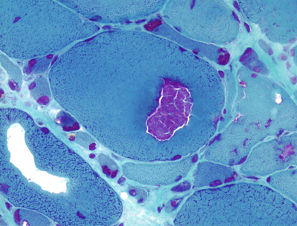
Biopsy in Inclusion Body Myositis
Light microscopy shows myofibers with vacuoles or cracks some of which are lined by basophilic granules. These are best seen in cryostat sections stained with modified Gomori trichrome.
By electron microscopy, the abnormal fibers contain paired helical filaments similar to those of Alzheimer's disease, straight filaments, myelinoid membranous bodies, increased glycogen, and abnormal mitochondria.
The filamentous inclusions of IBM have the optical properties of amyloid and contain beta amyloid, hyperphosphorylated tau protein, apolipoprotein E, presenillin 1, prion protein, and other proteins.
The inflammatory component of IBM consists of cytotoxic T cells and macrophages, similar to polymyositis.
The pathogenesis of IBM is not known but probably involves ageing of myofibers, oxidative damage, and an unknown trigger that initiates inflammation.

Slide 32
IBM
Characteristic Findings :
Common presenting patient complaint : difficulty ambulating & frequent falls secondary to knee buckling from quadriceps weakness.
Weakness of the wrist and finger flexors is often disproportionate to that of their extensor counterparts.
Loss of finger dexterity and grip strength may be a presenting or prominent symptom as well
Both proximal and distal muscles are affected and, unlike polymyositis/dermatomyositis, asymmetry is common.
Early involvement of the knee extensors, ankle dorsiflexors and wrist/finger flexors is characteristic of IBM.
Sensory and autonomic dysfunction is not present except in patients with a concurrent polyneuropathy.

Slide 33
IBM
Myalgias, cramping and muscle tenderness are relatively uncommon.
Facial weakness and dysphagia may be found in approximately one third of patients.
It may manifest as a feeling of stasis, a need to swallow repeatedly, regurgitation or choking.
Clinical suspicion should be very high when the pattern of weakness affects the finger and wrist flexors out of proportion to the finger and wrist extensors or the knee extensors disproportionate to the hip flexors.
Prominent muscle atrophy, especially of the quadriceps, is common.
Facial muscle weakness may occur, but extraocular muscles are not affected and ptosis is not seen.

Slide 34
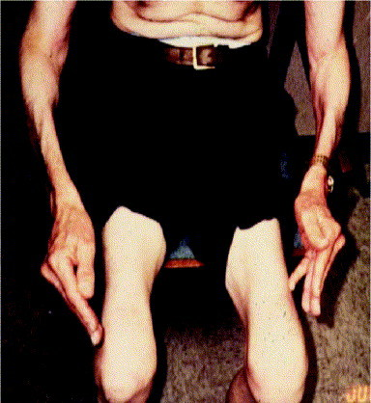
IBM
DTR’s may be normal or decreased.
Cognitive decline or UMN dysfunction is not seen and the presence of such findings should raise suspicion for other processes.
Examination for skin lesions, joint swelling/tenderness and other systemic signs suggesting a concomitant autoimmune disorder should be performed.

Slide 35
IBM
Differential Diagnosis :
Polymyositis
Dermatomyositis
CIDP
Myasthenia Gravis
Motor Neuron Disease
CIDP
Hypothyroid Myopathy
Recommended Lab Tests :
TFTs to rule out thyroid disease.
Standard serum studies (CBC, Chem 20).
ANA, rheumatoid factor (RF), double-stranded DNA (ds-DNA), ESR, scl-70, anti-Ro, and anti-La to rule out other autoimmune diseases.

Slide 36
Differential Diagnosis OF IBM
Motor Neuron Disease –
UMN signs are not present in IBM
Smaller MUAPs on EMG in IBM whereas there are fasciculation potentials in MND
Muscle biopsy in motor neuron disease reveals denervation atrophy.
Acid Maltase Deficiency -
Proximal weakness in acid maltase deficiency
Respiratory failure seen in about one third of adults with acid maltase deficiency
Insertional activity is prominently increased with CRDs and myotonic discharges in acid maltase deficiency
Muscle biopsy shows glycogen-laden vacuoles in acid maltase deficiency, not seen in IBM

Slide 37
Differential Diagnosis of IBM
Myasthenia Gravis –
Ptosis & opthalmoparesis not seen in IBM
repetitive nerve stimulation often shows abnormal decrement (rarely seen in IBM)
antibodies to Ach receptors or muscle-specific kinase (MuSK) absent in IBM
Hypothyroid myopathy –
Psychomotor slowing
Myxedema
Elevated TSH levels
CIDP –
Most CIDP patients have sensory signs & symptoms
NCVS consistent with demyelination
EMG shows chronic denervation & reinnervation with no myopathic changes in CIDP

Slide 38
IBM
Clinical features
Duration of illness greater than 6 months
Age of onset greater than 30 years old
Muscle weakness
Laboratory features
Serum CPK < 12 times normal
NCS/EMG studies
Muscle Biopsy is required for diagnosis
There is no effective treatment available for this disorder

Slide 39
EMG Findings in IBM
EMG / NCVS testing often reveals normal motor & sensory findings
EMG in the acute stage reveals myopathic MUAPs with increased insertional activity, fibs, PSWs & CRDs.
In the chronic stages some of the MUAPs are found to be high in amplitude, long in duration and polyphasic with satellite potentials.
Within 2 yrs of onset, it is common to encounter both long & short-duration MUAPs within the same muscle.
Because of the chronic nature of inclusion body myositis, needle EMG often discloses mixed myopathic & neurogenic features.
The heterogenous profile of IBM can make electrodiagnosis difficult – hence the necessity of biopsy

Slide 40
EMG Findings in IBM
Electromyographers have commented that the combination of neuropathic and myopathic findings on EMG should suggest IBM, however, this finding is simply consistent with a very chronic myopathy
The only EMG clue that the disorder is myopathic is that the magnitude of the MUAP abnormalities appears too great for the mild degree of decreased recruitment.

Slide 41
60 year old woman with 10 yr history of leg weakness & unsteadiness
Long history of impaired sensation over tips of fingers and toes
Long history of aching discomfort in both feet which worsens with weight bearing & activity
PMH : HTN
Family History : 30 yr old son seeing a podiatrist for problems with his feet

Slide 42
Physical Exam
Bilateral pes cavus deformities
No hammer toes
No skin changes
Atrophy of the intrinsics of both hands
Distal legs are thin
Unable to wiggle her toes
Pin & light touch sensation decreased in all four extremities in a glove & stocking distribution

Slide 43
Physical Exam
Manual Muscle Testing :
Toe Flexors & Extensors : 0/5
Ankle Dorsiflexors & Plantar Flexors : 4-/5
Hand Intrinsics : 4-/5
Deep Tendon Reflexes : +1 in uppers, 0 in lower extremities
Steppage gait noted; unable to walk on heels or toes

Slide 44
Sensory Conductions
Nerve | Latency | SNAP Amplitude | Conduction Velocity
Right & Left Sural | NR | NR | NR
Right & left Median | NR | NR | NR
Right & Left Ulnar | NR | NR | NR
Right & Left Radial | NR | NR | NR

Slide 45
Motor Conductions
Nerve | Latency | CMAP Amplitude | Conduction Velocity
R & L Tibial | NR | NR | NR
R & L Peroneal | NR | NR | NR
R & L Median | 10.9 /11.3 | 4.2/4.1 | 24/23.5
R & L Ulnar | 6.9 / 7.1 | 3.1/2.7 | 21/22.5

Slide 46
Needle EMG Findings
Muscle | Insertional Activity | Recruitment | Fibs / Positive Waves | Polyphasics
Tib Ant | Inc | Dec | +1 | NL
Med Gastro | Inc | Dec | +1 | NL
Abd Hallucis | Dec | Dec | Rare | NL
EDB | Dec | Dec | Rare | NL
FDL | Inc | Dec | +1 | NL

Slide 47
What is Your Diagnosis ?

Slide 48
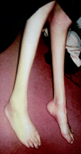
Answer
Findings are consistent with a primary, demyelinating, sensorimotor peripheral neuropathy
Uniform & symmetrical slowing of motor conduction studies in the absence of conduction block is suggestive of an inherited rather than an acquired disorder
Based on EMG, clinical findings, and family history, Charcot Marie Tooth Disease (HSMN) – Demyelinating Form is the most likely diagnosis

Slide 49
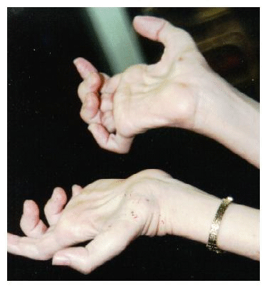
CMT
CMT 1 is a hereditary disorder with autosomal dominant mode of inheritance
Age of Onset varies between birth through age 40
Most common symptoms are related to muscle weakness, muscle atrophy, or foot deformity

Slide 50
CMT
Common foot deformities seen in CMT patients include pes cavus, hammer toes, and pes equinovarus
Common findings in CMT Type 1 seen on exam include distal muscle weakness, atrophy, distal areflexia or hyporeflexia and foot abnormalities
Distal loss of sensation is frequently noted
Pain is rare
Steppage gait and claw hands are seen late in the disease course

Slide 51
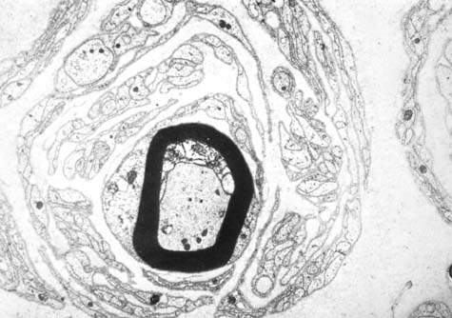
CMT
Enlargement of peripheral nerves is frequently seen in Type 1 patients
On the right : Onion bulb formation around a peripheral nerve in CMT Type 1 : Electron micrograph of sural nerve from an individual with CMT 1 showing characteristic concentric Schwann cell cytoplasmic processes surrounding a myelinated axon.

Slide 52
85 yr old Female with Progressive Leg Weakness & Myalgias
2 month history of progressive leg weakness and myalgias with significant difficulty going up stairs
No upper extremity weakness
No cramps or fasciculations
No sensory symptoms
No dysphagia, no SOB, no ocular symptoms
PMH : hypertension & hypercholesterolemia

Slide 53
85 yr old with Leg Weakness & Myalgias
Medications : Atorvastatin, Enalapril, Nifedipine, ASA, Atenolol
Neurological Exam : mild weakness in her deltoids and biceps bilaterally at 4+/5
Hip girdle musculature & hamstrings : 4/5 strength
Strength in her triceps, wrist extensors, wrist flexors, finger extensors, finger flexors, and interossei was 5/5 bilaterally
Neck flexor weakness was noted with 4-/5 strength

Slide 54
Exam :
Sensory : mild decrease in vibration in her toes
Gait : Narrow based and shuffling
Reflexes : +2 and symmetrical biceps, brachioradialis, triceps, patellar, and Achilles
Plantar reflexes were flexor

Slide 55
Sensory Conductions
Nerve | Latency | Amplitude | Velocity
R median | 2.85 | 21.6 | 51.00
R sural | 3.45 | 5.5 | 41

Slide 56
Motor Conductions
Nerve | Sites | Latency | Amplitude | Velocity
R Median | Wrist | 4.2 | 5
 | Elbow | 7.7 | 5 | 48.6
R Tibial | Ankle | 5.15 | 3.4
 | Popliteal Fossa | 15.5 | 2.9 | 40.6

Slide 57
Needle EMG
Muscle | Insertional Activity | Denervation Potentials | Amplitude | Duration | Recruitment
R Deltoid | Inc | 0 | Few Small | Short | Early
R Biceps | Inc | +1/Myotonic Discharges | Few Small | Short | Early
R FDI | Nl. | 0 | Nl. | Nl. | Nl.
R Iliopsoas | Inc | +1/Myotonic Discharges | Few small | Short | Early
R Vastus Lat | Inc | 0 | Few small | Short | Early
R Tib Ant | Inc | 0 | Nl. | Nl. | Nl.
R FHL | Nl. | 0 | Nl. | Nl. | Nl.
R Thoracic Paraspinals | Inc | +2

Slide 58
Questions
What is your differential diagnosis ?
What other recommendations and tests would you suggest ?

Slide 59
Answers
This is a myopathy with myotonic discharges
Myopathies which present with proximal weakness & myotonic discharges on EMG, but without clinical evidence of myotonia include :
acid maltase deficiency
inflammatory myopathies
myofibrillar myopathy
vacuolar myopathies
certain toxic myopathies, secondary to chloroquine & statin drugs.

Slide 60
Answers
What further work up is indicated ?
CPK level
A biopsy was performed to rule out a treatable inflammatory myopathy
Biopsy was performed of the left biceps muscle – which showed necrotic & regenerating fibers with no inflammatory infiltrates –
Why was the left biceps chosen for biopsy in this patient ?
Atorvastatin was discontinued and the patient improved over the course of several months.

Slide 61
51 yr old Male with Muscle & Joint Pains
A 51 year old male notes muscle & joint pains
Developed difficulty climbing stairs and standing from a seated position
No dysfunction of the upper extremities
Denies a family history of similar complaints

Slide 62
51 year old with Muscle & Joint Pain
Physical Exam : Slight proximal weakness in both lower extremities
Normal strength in the upper extremities
DTRs hypoactive & symmetric
Plantar responses were flexor
No muscle tenderness
No skin changes

Slide 63
How Would You Structure An EMG Study to Investigate this Problem?

Slide 64
Sensory Conductions
Sensory Nerve Action Potentials | Latency | Amplitude
Left Median | 2.3 | 25.0
Left Ulnar | 2.2 | 21.0

Slide 65
Motor Conductions
Motor Nerve | Latency | Conduction Velocity | Amplitude
Left Median | 3.2 | 53 | 8.0
Left Peroneal | 5.8 | 50 | 6.2

Slide 66
EMG Findings
Muscle | Findings
Left brachioradialis | Fibrillations & positive sharp waves. Normal & short duration low amplitude MUPs on volition
L & R Quadriceps | Fibrillation potentials and positive sharp waves at rest. Normal & short duration low amplitude MUPs on volition
Left EDB | Fibrillation potentials & positive sharp waves at rest. Normal MUPs on volition
Right Gastrocnemius | Silent at rest. Normal MUPs on volition

Slide 67
What Do You Think is the Diagnosis ?
CPK , SGOT, LDH, Rheumatoid factor and ESR were all elevated
Tests for occult carcinoma including chest xray, upper gi series, bone scan, and liver ultrasound were negative

Slide 68
Diagnosis
Inflammatory Myopathy – Polymyositis

Slide 69
Polymyositis
Polymyositis is an inflammatory myopathy which is an autoimmune disorder which affects primarily women
Inflammatory Myopathies typically present with MUAP changes on EMG and denervation potentials (fibs and positive sharp waves)
Types of inflammatory myopathies :
Polymyositis / Dermatomyositis
Inclusion Body Myositis
Sarcoid Myopathy
HIV Related Myopathy
It is more commonly seen in African Americans than in Caucasians or Asians
Most patients present with muscle weakness which develops subacutely over weeks or months, affecting primarily the pelvic and shoulder girdle muscles, including the neck flexors

Slide 70
Polymyositis
Dysphagia, myalgia and muscle tenderness are common
Extramuscular manifestations are common, some of these extra-muscular manifestations are associated with circulating antibodies to anti-Jo-1 (an anti -tRNA synthetase) autoantibodies
Cardiomegaly / CHF / Conduction Block
Interstitial Pneumonia
Diffuse necrotizing vasculitis (seen esp. in childhood dermatomyositis)
Renal Involvement
Raynaud’s Phenomenon
Arthralgia

Slide 71
Polymyositis
Elevated serum CPK is common, seen in 90% of all patients, - in the range of 5 – 10 times the upper limit of normal
LDH & SGOT are usually elevated
ESR is normal or mildly elevated
Autoantibodies such as ANA, SSA, SSB are positive in the overlap syndromes

Slide 72
Polymyositis and Malignancy
The incidence of malignancy in patients with dermatomyositis who are > 40 yrs old is higher than expected in the general population
The neoplasms are variable, with carcinoma of the ovary and the stomach being most frequently reported
The association between polymyositis and malignancy in patients older than age 40 is less clear and continues to be debated

Slide 73
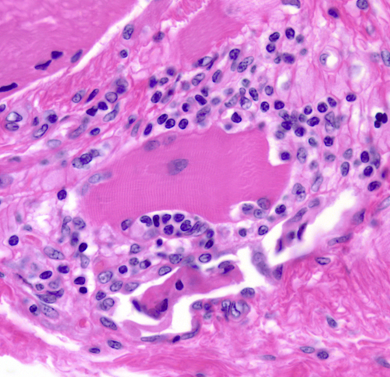
Biopsy in Polymyositis
Biopsy is diagnostic, allowing the clinician to distinguish this inflammatory myopathy from inclusion body myositis
Necrosis affects all types of fibers
Phagocytosis & muscle fiber regeneration as well as lymphocytic infiltration is seen in the absence of cytoplasmic inclusion bodies

Slide 74
Polymyositis – EMG Findings
Characteristic EMG findings in polymyositis include :
short duration, low amplitude, polyphasic motor units
Fibrillation potentials and positive sharp waves are present
Early recruitment is seen
Complex repetitive discharges may be seen

Slide 75
Treatments
Steroids
Azathioprine
Methotrexate
Immunoglobulins

Slide 76
Thanks for Your Attention
Questions ?

